Slide 1
Extracting the minimum node and its Analysis, Decreasing a key in Fibonacci Heap and its cost involved
By
Mr. Gururaj
Assistant Professor-Selection Grade
Department of Computer Science & Engineering
M.I.T Manipal

Slide 2
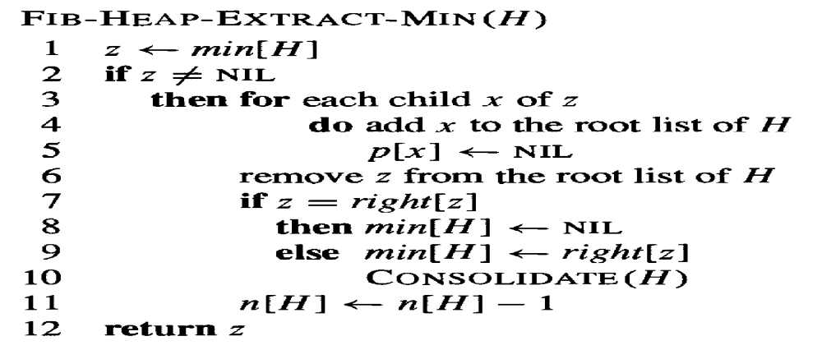
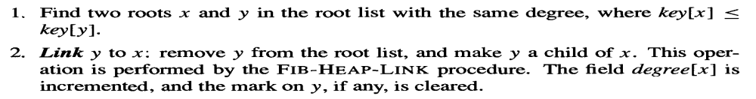
Extracting the minimum node

Slide 3
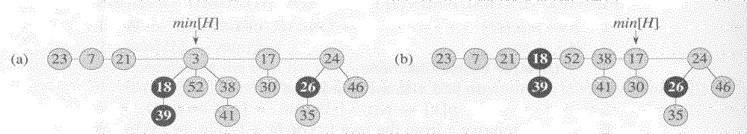
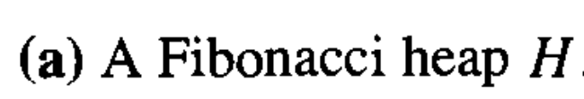
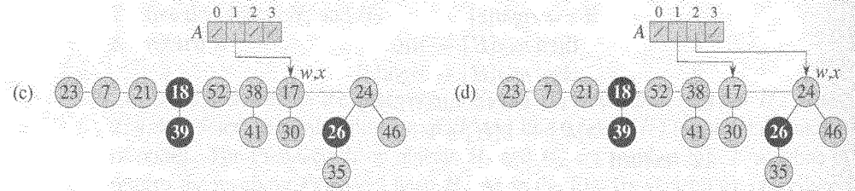
Extracting the minimum node

Slide 4
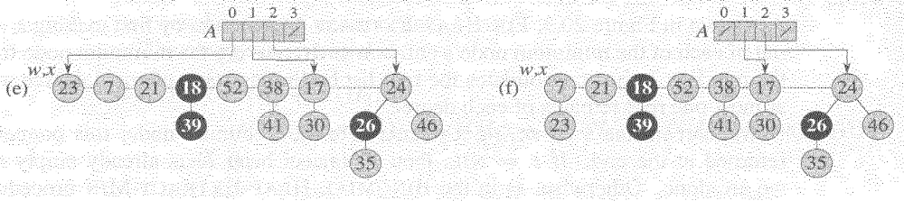
Extracting the minimum node

Slide 5
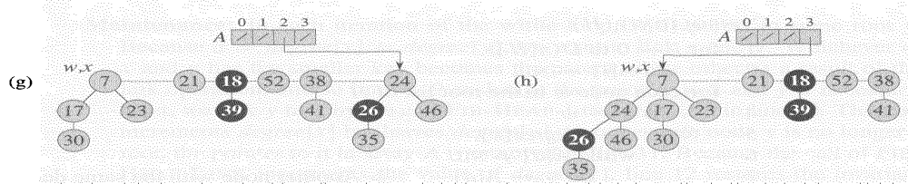
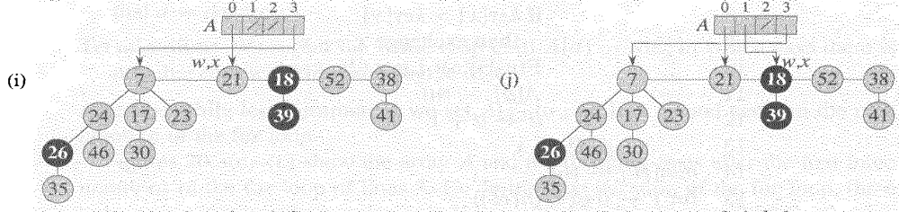
Extracting the minimum node and its Analysis

Slide 6
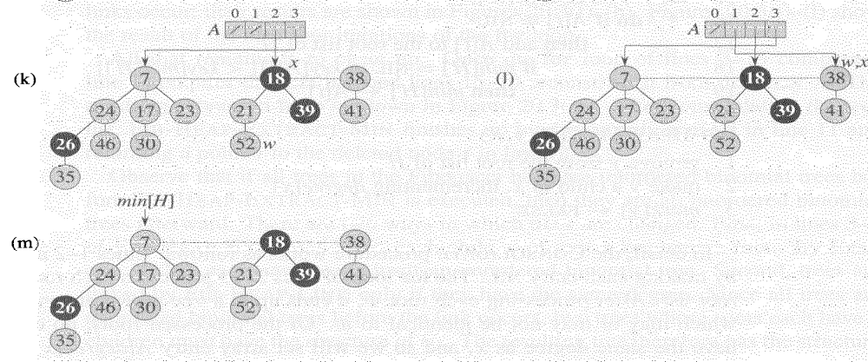
Extracting the minimum node and its Analysis

Slide 7
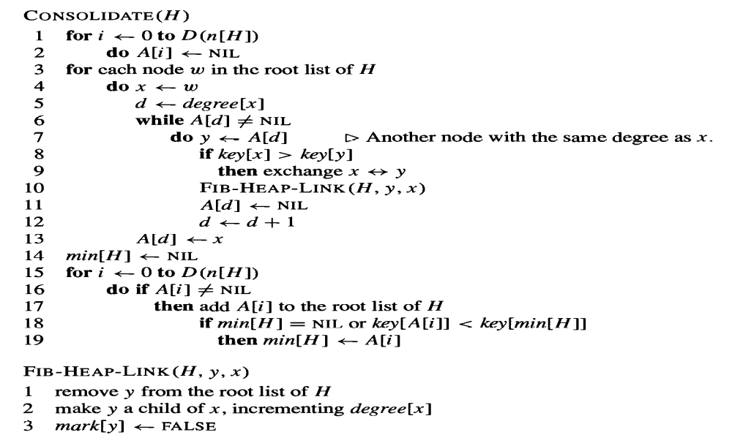
Extracting the minimum node and its Analysis

Slide 8
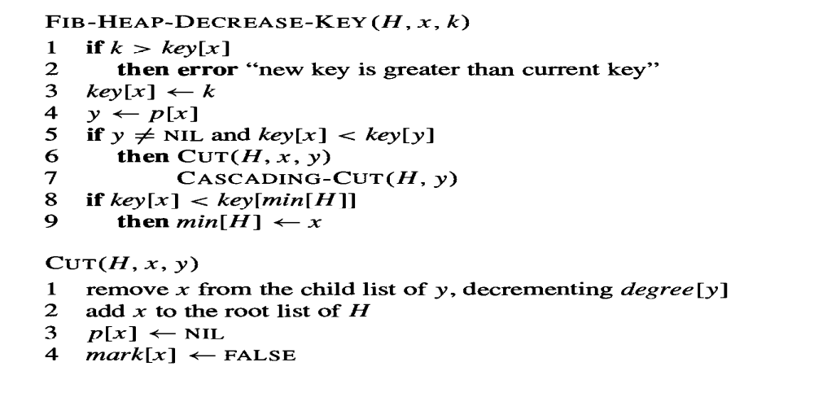
Decreasing a key in Fibonacci Heap

Slide 9
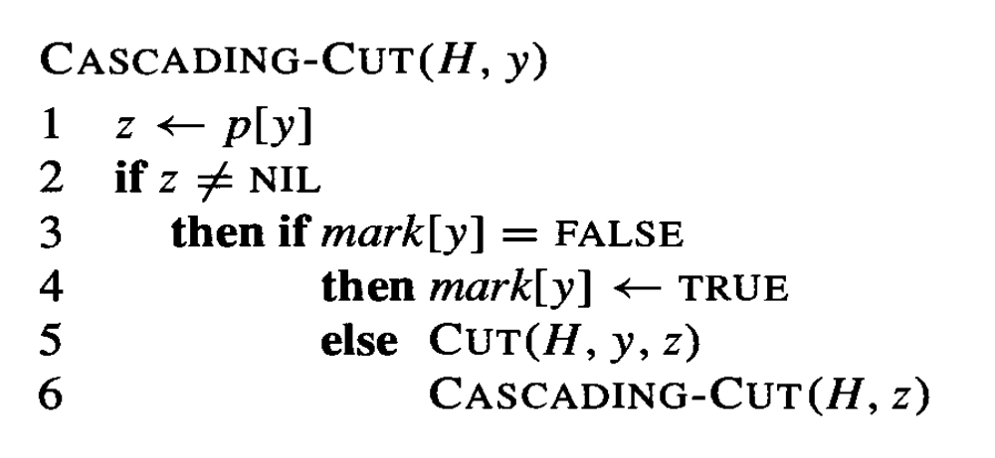
CASCADING-CUT

Slide 10
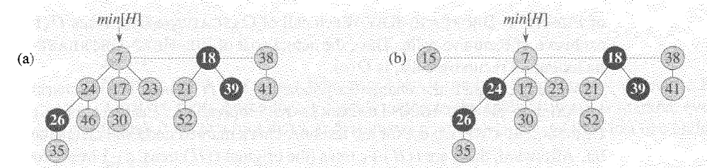
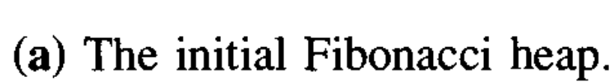
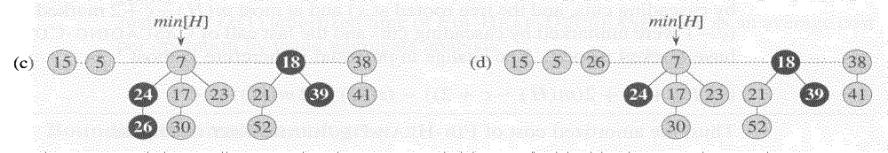
The node with 46 has its key decreased to 15

Slide 11
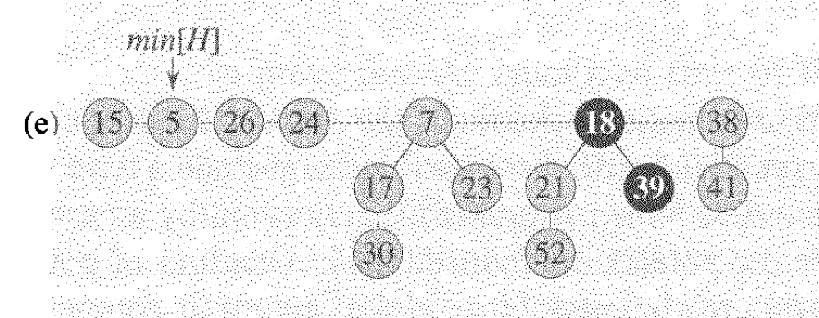

Slide 12
Decrease key Analysis
The amortized cost of FIB-HEAP-DECREASE-KEY is only O(1).
The FIB-HEAP-DECREASE-KEY procedure takes O(1) time, plus the time to perform the cascading cuts.
Suppose that CASCADING-CUT is recursively called c times from a given invocation of FIB-HEAP-DECREASE-KEY.
The actual cost of FIB-HEAP-DECREASE-KEY, including all recursive calls, is O(c).
The change in potential is therefore at most
((t(H) + c) + 2(m(H) - c + 2)) - (t(H) + 2m(H)) = 4 - c.
Thus, the amortized cost of FIB-HEAP-DECREASE-KEY is at most
O(c) + 4 - c = O(1),
since we can scale up the units of potential to dominate the constant hidden in O(c).

